Slide 1
Progress week 1
Jan van Eck

Slide 2
In this progress report
Check if APID and HuRi data are correct
Merge APID and HuRi
Train/Validate/Test split
Questions
Supplements

Slide 3
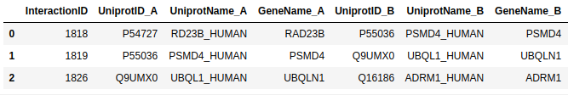
APID PPIs
Only Binary and no inter-species interactions
PPIs: 66206
Unique proteins: 13317
Example:

Slide 4
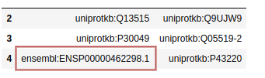
HuRi PPI (PSI File)
Test results are filtered out
Most important columns are:
58 Ensembl protein ids were found in the Uniprot columns
UniProt mapping tool could not map the ENSP ids to UniProtKB
BioMart could map 34 ENSP to UniProtKB (24 proteins missing)
UniProt ID A | UniProt ID B | Ensemble G/T/P id A | Ensemble G/T/P id B

Slide 5
Difference between HuRi UniProt and ENSP ids
A uniprot ID can have multiple ENSP ids
The paper counts all the possible ENSP combinations as PPIs
Paper claims 52569 PPIs
The dataset contains combinations: 52549 PPI
missing 20 compared to paper
Example of multiple ENSP ids for one UniProtKB id:
UniProtKB A | UniProtKB A | Ensembl G/T/P A | Ensembl G/T/P B
O75920-1 | A1L3X0 | ensembl:ENST00000380750.7|ensembl:ENSP00000370126.3|ensembl:ENSG00000205572.9|ensembl:ENST00000354833.7|ensembl:ENSP00000346892.3|ensembl:ENSG00000172058.15 | ensembl:ENST00000508821.5|ensembl:ENSP00000424123.1|ensembl:ENSG00000164181.13

Slide 6
HuRi PSI-MI file unique Gene combinations
Website claims: 52548 ENSG combinations
Again, a UniProtID can have multiple ENSG ids
After creating all possible ENSG id combinations we also get 52548 gene combinations from the PSI-MI file (so this matches)

Slide 7
Unique proteins HuRi
Paper claims: 8275 PPIs
Using all ENSP ids in dataset: 8274 PPI
missing one protein compared to paper
Using only UniProtKB A/B column: 8215 proteins
When removing entries with unmappable ENSP ids: 8184 (31 missing)
7 extra proteins missing on top of the original 24 unmappable ENSPs ids because they only occured in combination with unmappable ENSP id.

Slide 8
Merge APID and HuRi
ENSP to UniProtKB mappings gives worse result so we should work with UniProt ids
After merging:
Unique proteins: 15364
PPIs: 111886
What are we missing?
PPIs from HuRi: 553
Unique proteins from HuRi: 47
No missing data from APID
Main reason for missing data:
24 ENSP ids unable to map to uniprot ids
7 Uniprot ids which were only connected to one or more of the 24 unmappable ENSP ids
16 Uniprot isoforms not found using the UniProtKB mapping tool

Slide 9
Train/Validate/Test split
This paper shows that using the same train/validation/test splits of the same datasets, as well as making significant changes to the training procedure (e.g. early stopping criteria) precludes a fair comparison of different architectures:
https://arxiv.org/pdf/1811.05868.pdf
They also show that simpler GNN architectures (GraphSAGE) are able to outperform the more sophisticated ones when they use 100 randomized train/val/test splits:
Maybe we should think about creating multiple train/val/test splits as well

Slide 10
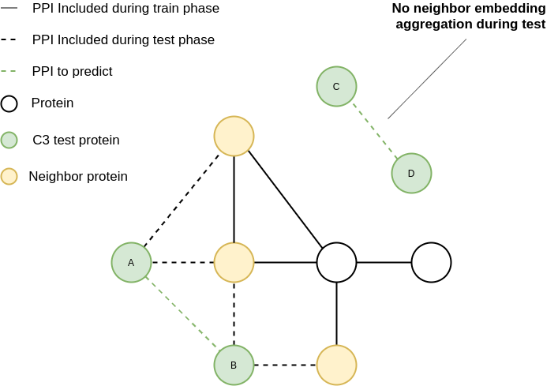
Train/Test set?
Graph conv networks are based on neighbor embedding aggregations
Can we include the edges of C3 (A,B) when testing while excluding all the edges of (A,B) during training?
We need to think about the best GNN algorithm for C3. If we can only use (C,D) like network components for C3, basic GCN will probably not work.

Slide 11
Questions
Can you check the code for merging APID and HuRi in this order?
https://github.com/janvaneck1994/stage2/blob/master/Research/APID%20analyses.ipynb
https://github.com/janvaneck1994/stage2/blob/master/Research/HuRi%20analyses.ipynb
https://github.com/janvaneck1994/stage2/blob/master/Research/Merge%20APID%20and%20HuRi.ipynb
Should we do something with the missing 47 proteins?
Is there any code example for C1, C2, C3 splitting?
Should we create multiple train/val/test splits (slide 9)?
Can we include the edges of C3 when testing while excluding all the edges of C3 during training? (slide 10)

Slide 12
Theory
Usefull GNN methods for edge prediction:
Graph Convolutional Networks from Kipf and Welling:
Semi-Supervised Classification with Graph Convolutional Networks
GraphSAGE from Hamilton et al.:
Inductive Representation Learning on Large Graphs
Graph Isomorphism Networks (GIN) from Xu et al.:
How Powerful are Graph Neural Networks?

Slide 13
Video lectures:
Graph Convolutional networks (17:13):
https://www.youtube.com/watch?v=7JELX6DiUxQ
Graphsage explanation (51:09):
https://www.youtube.com/watch?v=7JELX6DiUxQ
GIN explanation:
https://www.youtube.com/watch?v=H6oOhElB3yE

Slide 14
Code examples
GCN PPI prediction using TensorFlow
http://snap.stanford.edu/deepnetbio-ismb/ipynb/Graph+Convolutional+Prediction+of+Protein+Interactions+in+Yeast.html
Graphsage implementation using PyTorch:
https://github.com/bkj/pytorch-graphsage https://towardsdatascience.com/hands-on-graph-neural-networks-with-pytorch-pytorch-geometric-359487e221a8
PyTorch Geometric for GNN implementations: https://pytorch-geometric.readthedocs.io/en/latest/modules/nn.html#torch_geometric.nn.conv.SAGEConv

Slide 15
What to do next
Set up a script to generate SeqVec embeddings
Graph analyses of the new interactome
C1, C2, C3 splits
Reading literature

Slide 16
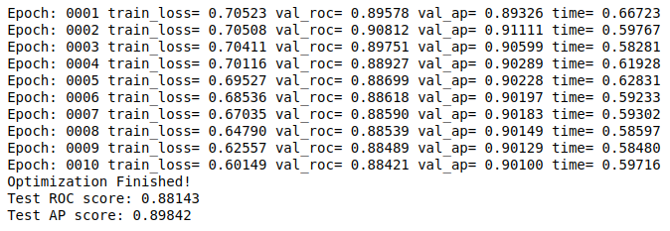
The future looks bright
When using this implementation of a basic GCN on the HuRi PPIs (HuRi+APID gave GPU memory issues) without SeqVec embeddings, I get an AUC of 88 with a 2% test split which translates to a C1 test:
http://snap.stanford.edu/deepnetbio-ismb/ipynb/Graph+Convolutional+Prediction+of+Protein+Interactions+in+Yeast.html

